Slide 1
Disaster Management Plan by Local Governments
Joy Elamon
Director General, KILA

Slide 3
Remembering Tsunami.mp4

Slide 4
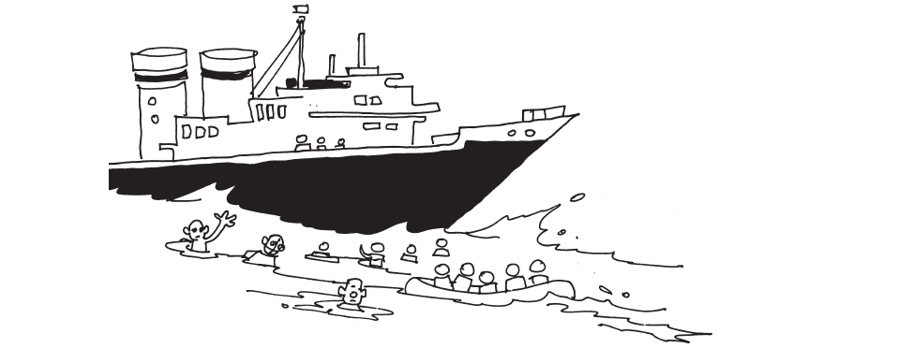
Okhi in 2016
Okhi in 2016.mp4

Slide 5
2018 August in Kerala
flood videos\Floods 1.MPG
flood videos\Floods 2.MPG
flood videos\Floods 3.MPG

Slide 6
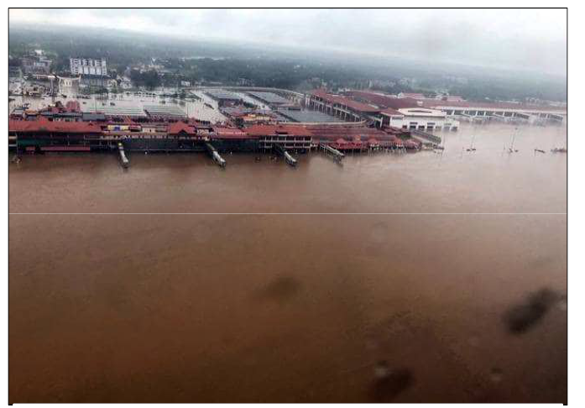
Where are We?

Slide 7
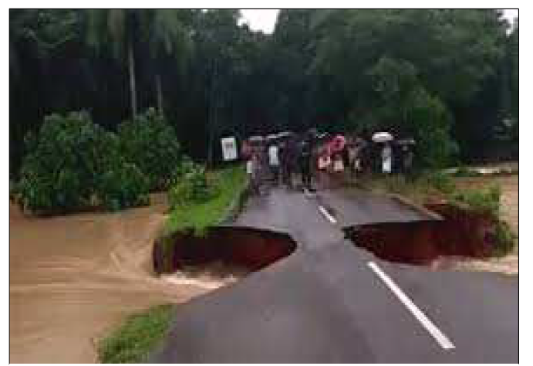
Nature at its Worst
Nilamboor Road

Slide 8
Together We Move
Rescue Operation by Local Volunteers

Slide 9
In the Times of Disasters
It is an emergency
It is War Situation
Deal it like in a war
There needs to be coordinated efforts
Uniformed and Non-Uniformed forces to come together
There should not be any confusion, miscommunication
Role clarity
Single point of command
Single line of communication
Command and Control

Slide 10
Who can Do this in
Your State?

Slide 11
In Disasters
Who is the First Respondent?
Who Knows the Area?
Who Understands the Community?

Slide 12
Managing Disasters – The System
Based on National Disaster Management Act
National Disaster Management Authority
Prime Minister as Chairperson
State Disaster Management Authority
Chief Minister as Chairperson
District Disaster Management Authority
Chairperson is the Collector or District Magistrate or Deputy Commissioner
Elected representative of the area is member of the DDMA as an ex-officio Co-Chairperson

Slide 13
Disaster Management Plans
National
State
District
The District Plan shall be prepared by the District Authority,
after consultation with the local authorities and
having regard to the National Plan and the State Plan,
to be approved by the State Authority

Slide 14
District Disaster Management Plan
(a) the areas in the district vulnerable to different forms of disasters;
(b) the measures to be taken, for prevention and mitigation of disaster, by the Departments of the Government at the district level and local authorities in the district;
(c) the capacity-building and preparedness measures required to be taken by the Departments of the Government at the district level and the local authorities in the district to respond to any threatening disaster situation or disaster;
(d) the response plans and procedures, in the event of a disaster, providing for— (i) allocation of responsibilities to the Departments of the Government at the district level and the local authorities in the district; (ii) prompt response to disaster and relief thereof; (iii) procurement of essential resources; (iv) establishment of communication links; and (v) the dissemination of information to the public; (e) such other matters as may be required by the State Authority.

Slide 15
Disaster Management Plan
Every office of the Government of India and of the State Government
at the district level and the local authorities shall,
subject to the supervision of the District Authority,—
(a) prepare a disaster management plan

Slide 16
Where is the Local Government?

Slide 17
Local Authority
“local authority” includes Panchayati Raj institutions,
municipalities, a district board, cantonment board,
town planning authority or Zila Parishad or any other body or authority,
by whatever name called, for the time being invested by law,
for rendering essential services or, with the
control and management of civic services, within a specified local area;

Slide 18
Responsibilities of LSGs in Disaster Management
Local Authority should ensure that its officers and employees are trained in disaster Management
Local Authority should maintain resources related to disaster management so that it can be readily available at any time.
Local Authority should ensure that all the construction projects under its jurisdiction confirms the standards and specifications by National, State and District Authority.

Slide 19
3 Rs
Local Authority should carry out 3 Rs
Relief
Rehabilitation
Reconstruction

Slide 20
Disaster Management
A continuous and integrated process of planning, organising, coordinating and implementing measures which are necessary or expedient for—
(i) prevention of danger or threat of any disaster;
(ii) mitigation or reduction of risk of any disaster or its severity or consequences;
(iii) capacity-building;
(iv) preparedness to deal with any disaster;
(v) prompt response to any threatening disaster situation or disaster;
(vi) assessing the severity or magnitude of effects of any disaster;
(vii) evacuation, rescue and relief;
(viii) rehabilitation and reconstruction;
Are We There?

Slide 21
Kerala LSGs responded to 2018 Disasters
From Warning to rescue, relief, rehabilitation, reconstruction
Local governments become the fulcrum of activities
flood videos\Camp 1.MPG
Next round of floods – Flooding of grievances
Whom to approach and who will respond?
New Working Group for GPDP
Environment, Biodiversity, Climate Change and Disasters

Slide 22
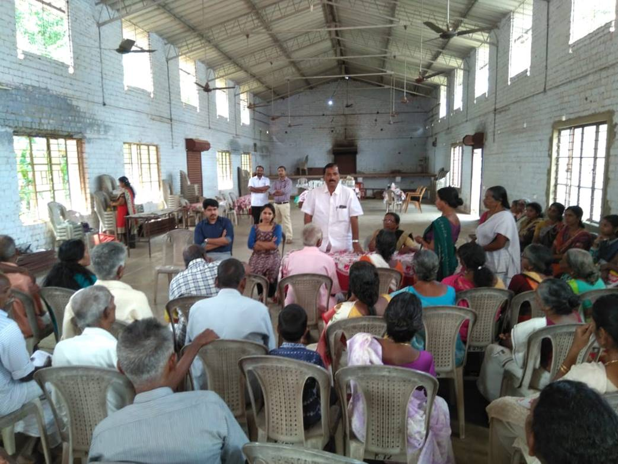
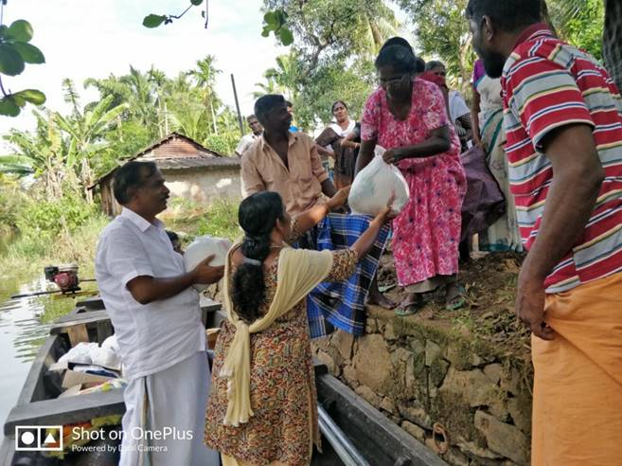
Local Governments in Disaster Management

Slide 23
KILA and Local Governments before the floods
Centre on Climate Change, Biodiversity and Environment
Developed Methodology and Tools for a Local Action Plan on Climate Change (LAPCC)
Trainings
A few GPs have already developed LAPCC
BMCs in place
Biodiversity registers

Slide 24
Rebuilding Kerala
Rebuild Kerala Initiative – Towards a new paradigm in development
Nammal Nammukkayi - A new people’s campaign, also to equip the society to manage disasters
Local authority for Nammal Nammukayi campaign is Local Self Governments of Kerala

Slide 25
Towards a Local Government Disaster Management Plan
All GPs, Municipalities and Corporations to prepare DM Plan
Department of LSGs provided Framework, Templates and Guidelines
KSDMA provided technical support
KILA in the capacity building and coordinating role

Slide 26
Who Does It
DM Plans under the leadership of LSG Steering committee
With the support of working group for Environment, Climate change, Biodiversity and Disaster Management
Other sectoral working groups to join
A group of 20 volunteers (LRGs) in every LSG to support DM Plan preparation
At least 20 volunteers from every ward
CBOs, NGOs, residents associations and others
Kudumbashree
2.5 lakh people in Action

Slide 27
How
LRGs with working groups to conduct group discussions, data collection, transect walk, focus group discussion etc.
KSDMA provided around 31 layers of maps to every LSG
Analysis of data collected and maps
Suggestions for disaster management plan
Discussion the Gram Sabha
Special Development Seminar on Disaster Management

Slide 28
Further Steps
Incorporation in GPDP
Integration of DM plan into GPDP
DM Plan to be sent to DPC
Vetting by DPC
District level seminar
To DDMA
District Disaster Management Plan

Slide 29
What does it Contain
Suggested Actions for
Mitigation, Preparedness, Rescue, relief, rehabilitation,
Responsibilities
Projects to be included in GPDP
Suggestions to other tiers of LSGs, departments, district administration, state government
Teams formed (ERTs)

Slide 30
Building Capacities
“capacity-building” includes—
identification of existing resources and resources to be acquired or created;
acquiring or creating resources identified under sub-clause (i);
organisation and training of personnel and coordination of such training for effective management of disasters
Trainings for this DM Plan preparation were organised by KILA in association with KSDMA
Various Phases

Slide 31
1st Phase DM Training

Slide 32
2nd Phase DM Training

Slide 33
3rd Phase DM Training

Slide 34
4th Phase DM Training

Slide 35
Maps for Panchayath Disaster Management Plan
Avarnoor Gramapanchayath
Prepared by
Kerala State Emergency Operations Centre(KSEOC)
KSDMA

Slide 36
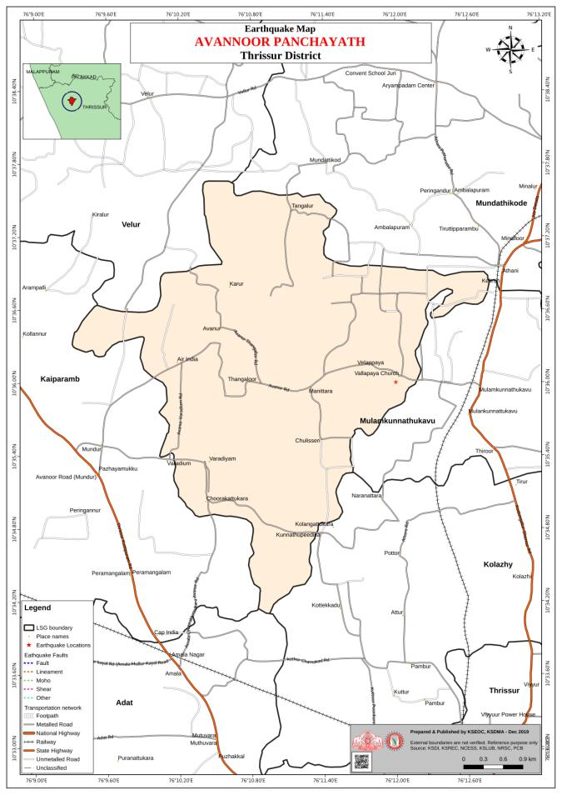
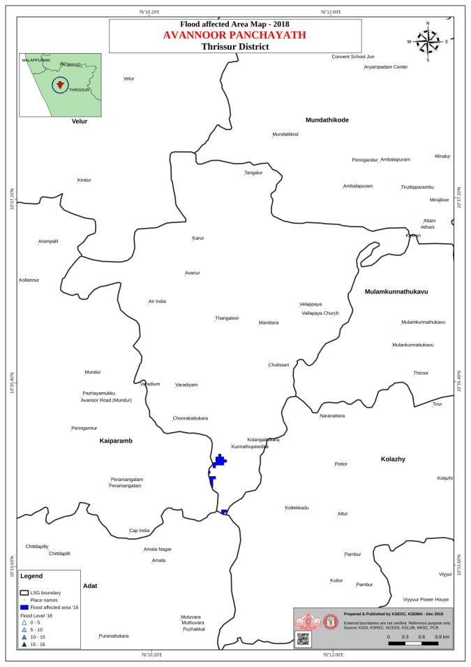

Slide 37
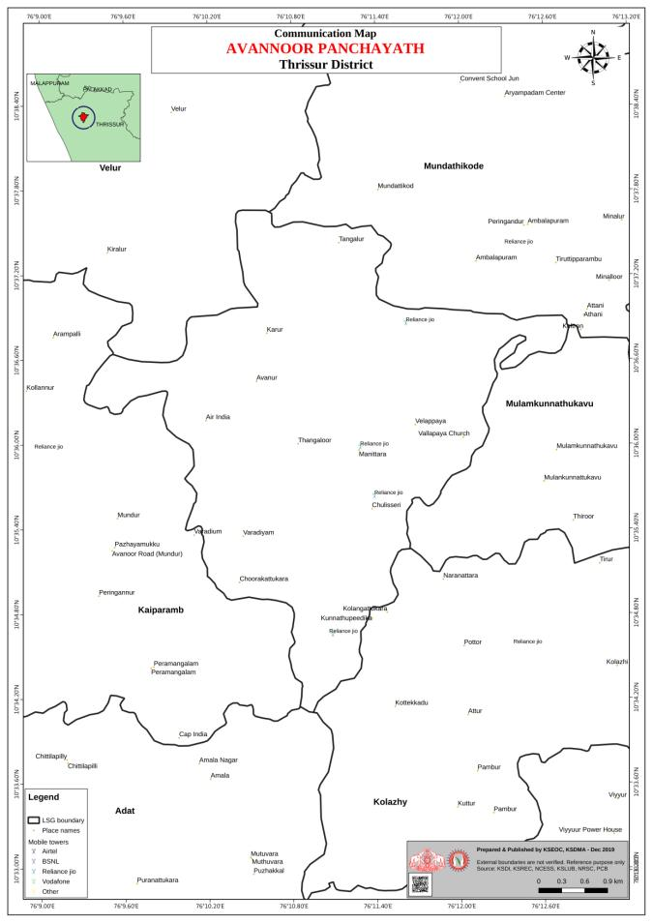
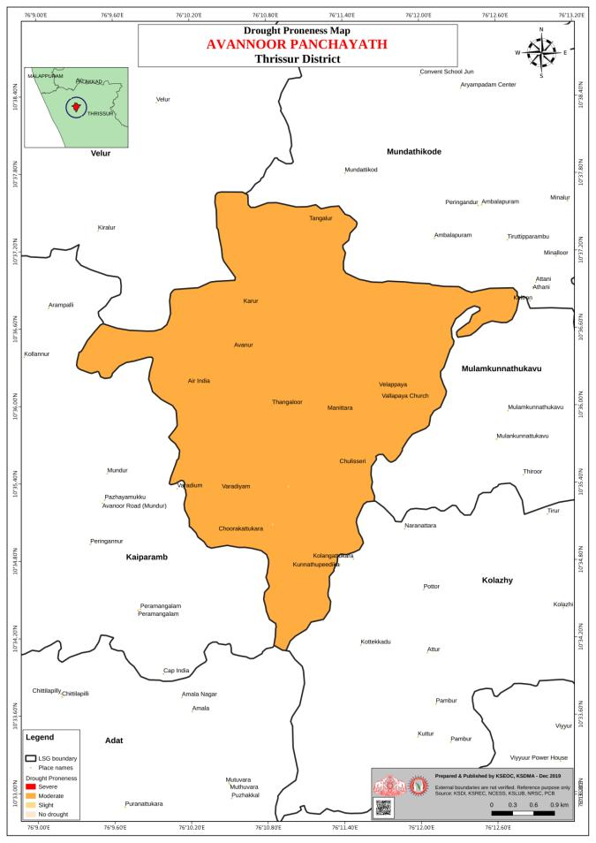

Slide 38
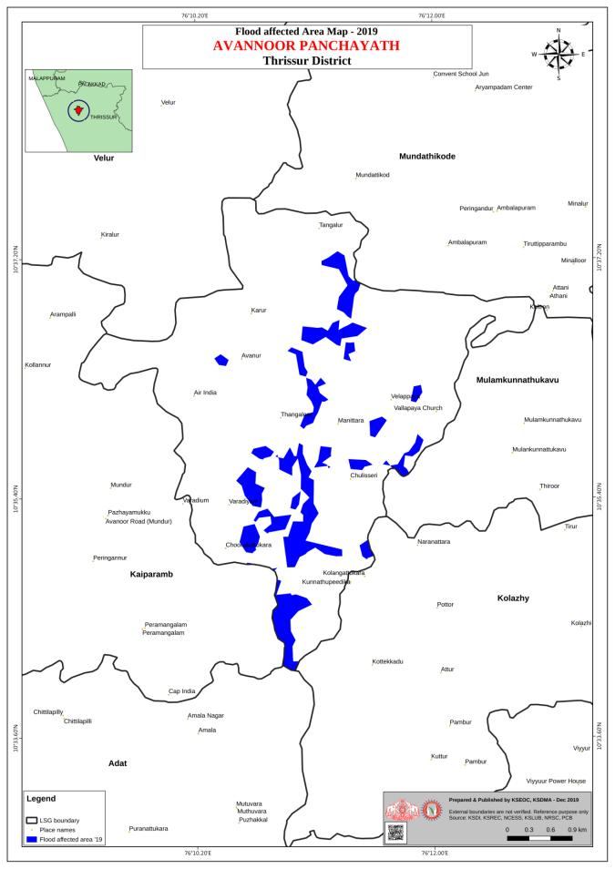
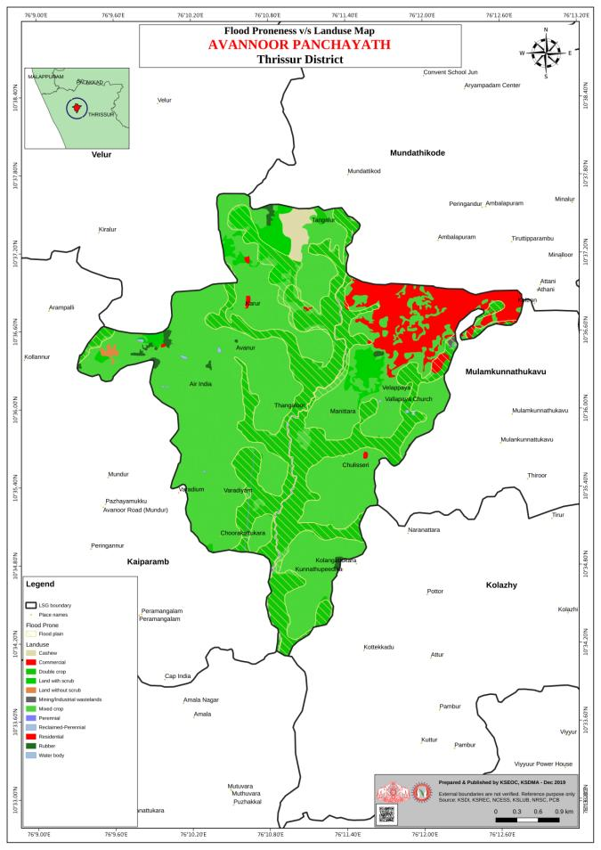

Slide 39
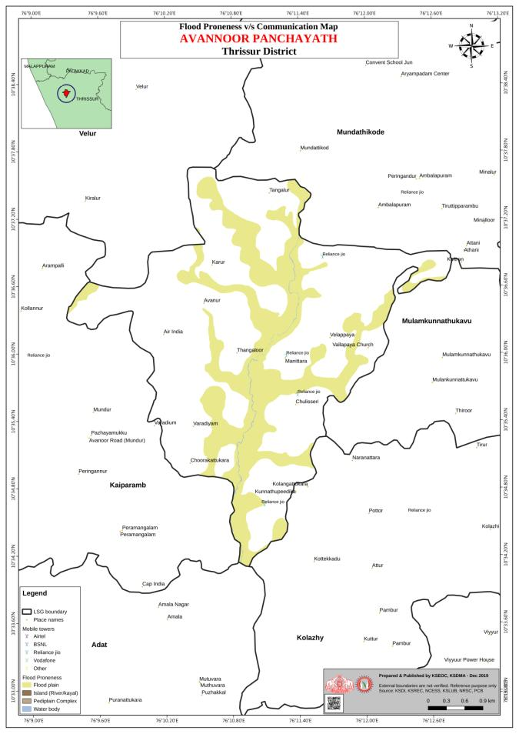
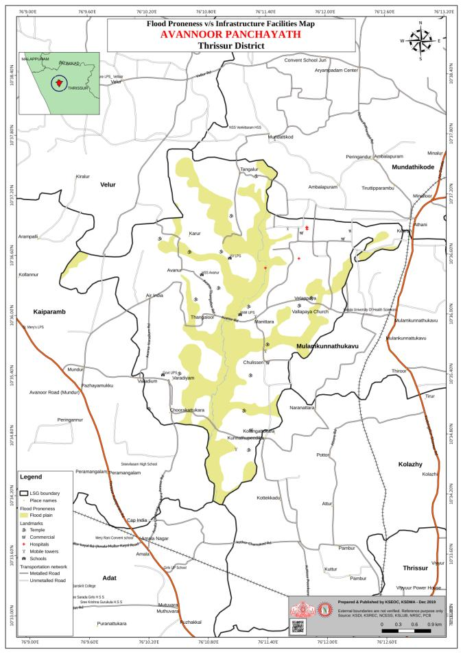

Slide 40
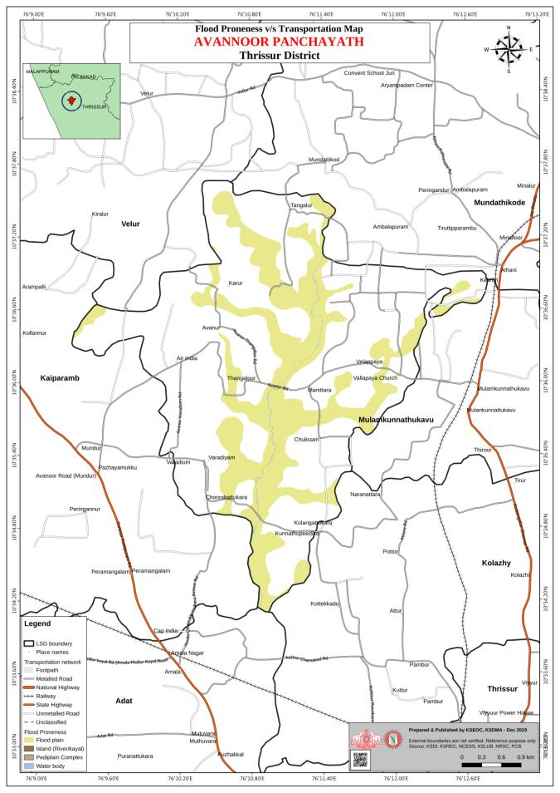
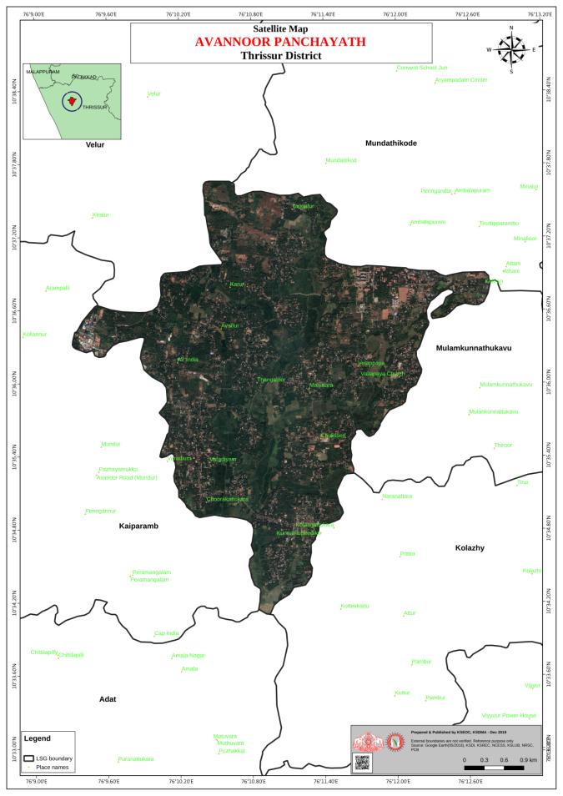

Slide 41
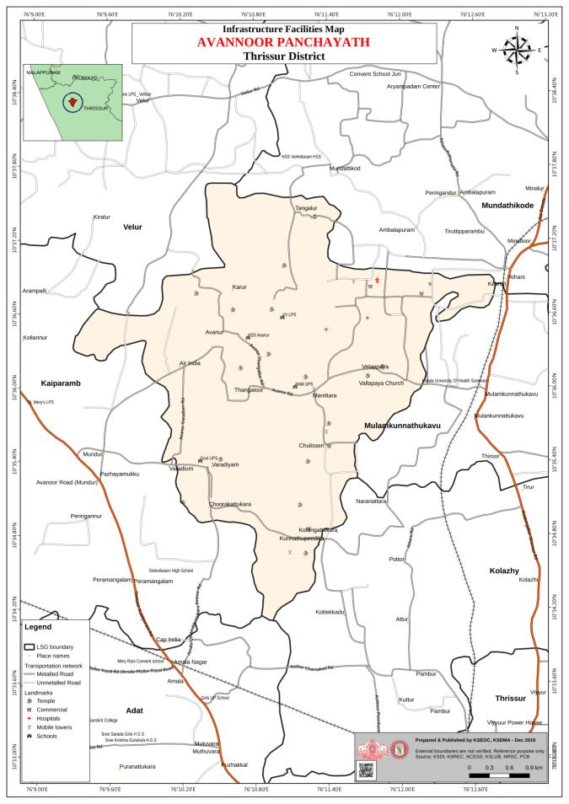

Slide 42
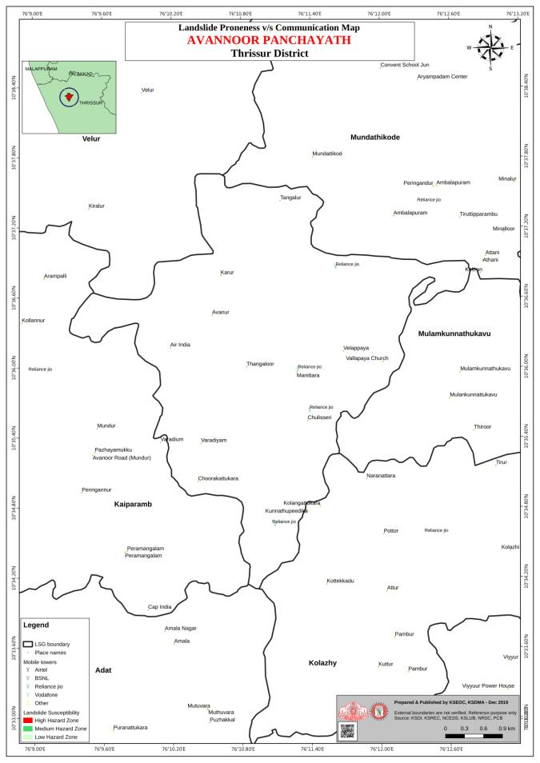

Slide 43
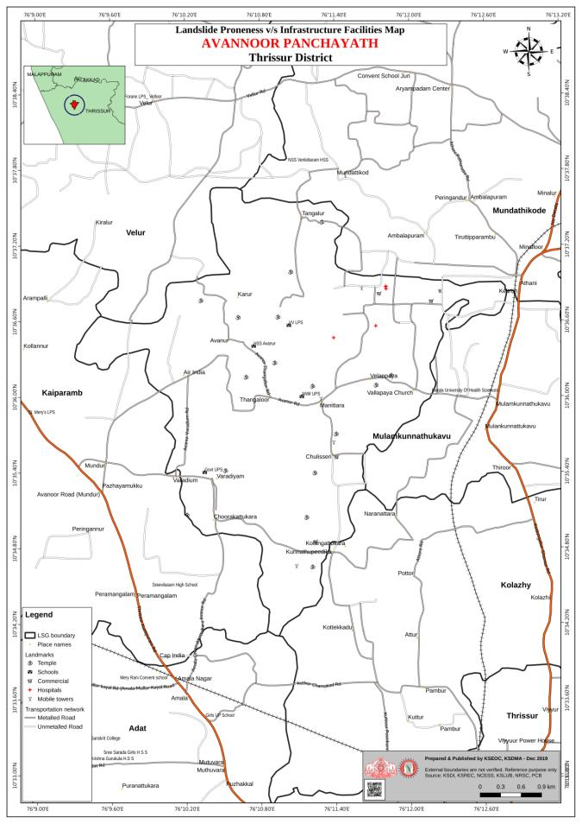
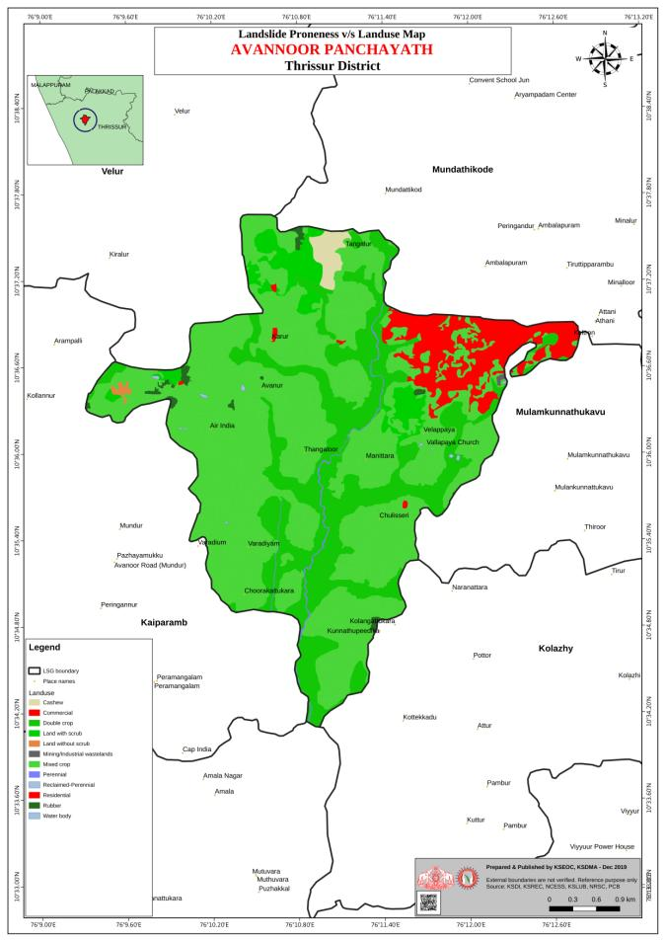

Slide 44
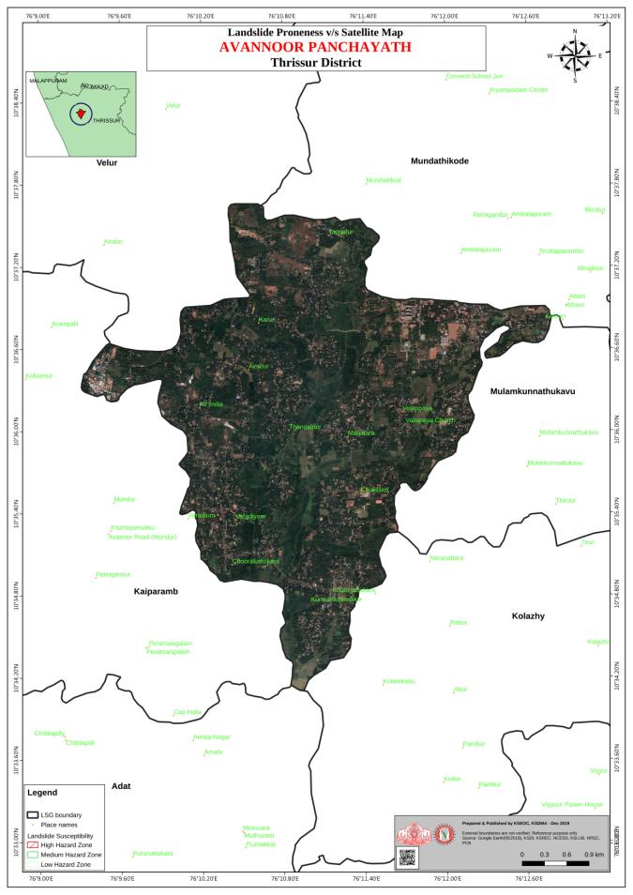
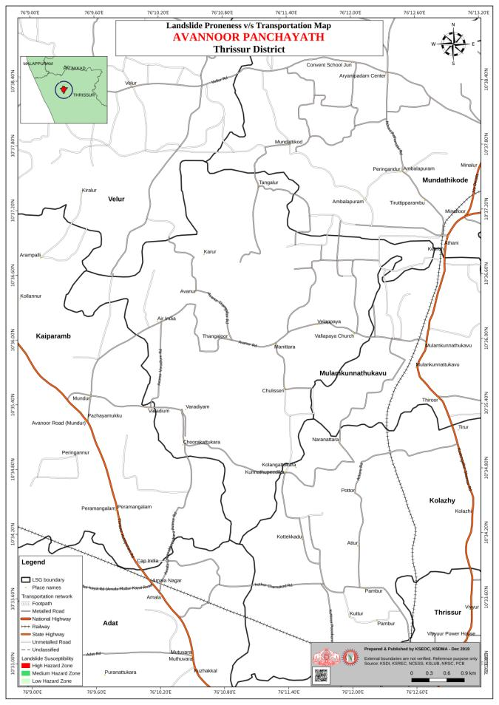

Slide 46
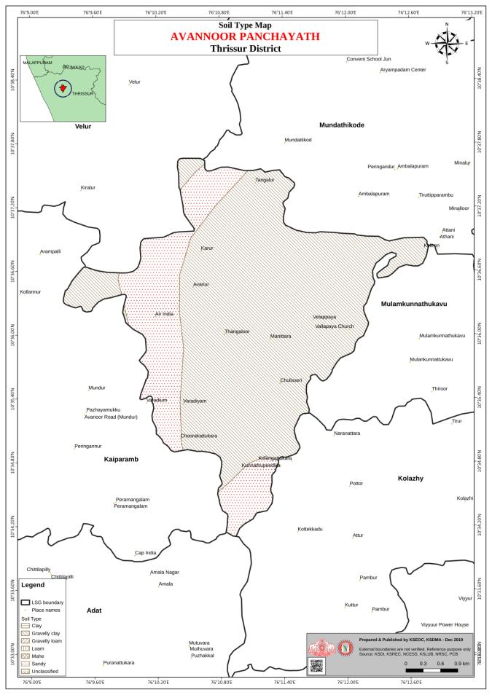
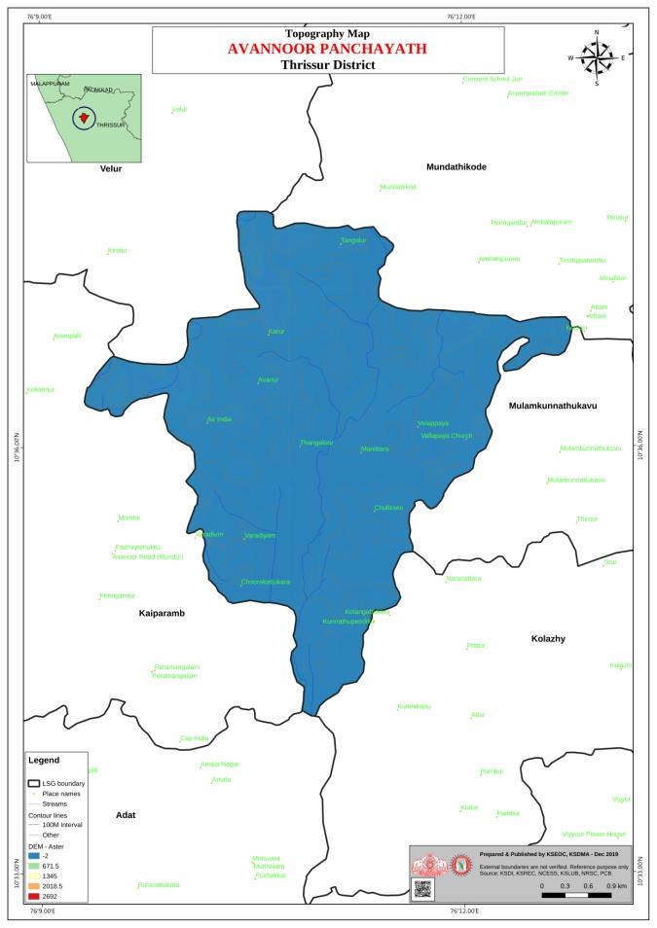

Slide 48
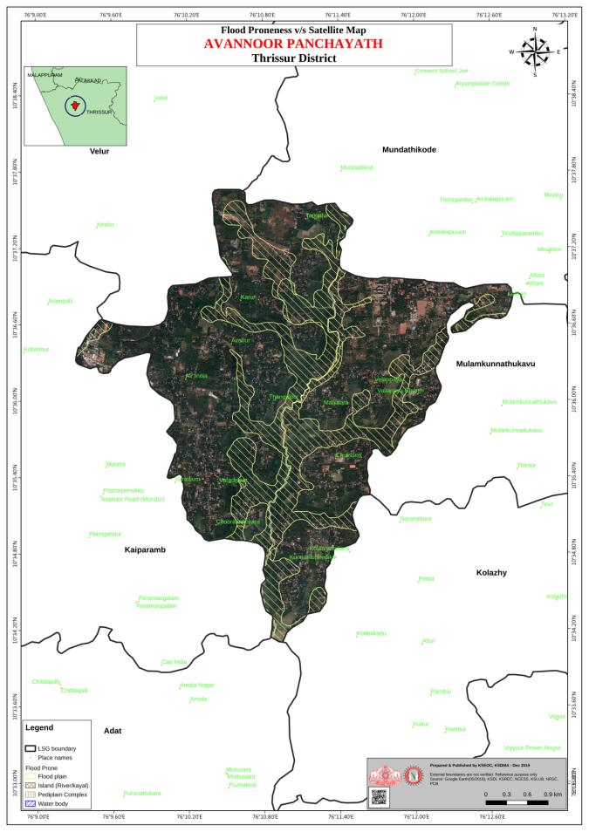

Slide 49
Gram Sabha in session

Slide 50
Structure of DM Plan

Slide 51
CHAPTER -1
General Information
Information about LSG
Revenue villages
Population statistics
Number of wards
Major occupation
Altitudes and latitudes

Slide 52
CHAPTER -2
Disaster Proneness and Analysis
Disaster prone areas
With the help of maps provided by KSDMA and data collected

Slide 53
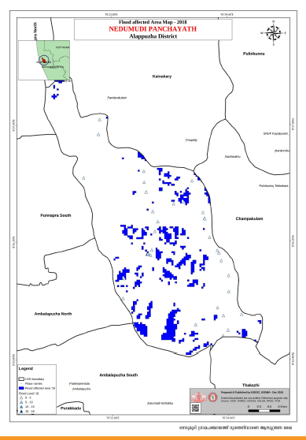
Maps
Flood prone areas

Slide 54
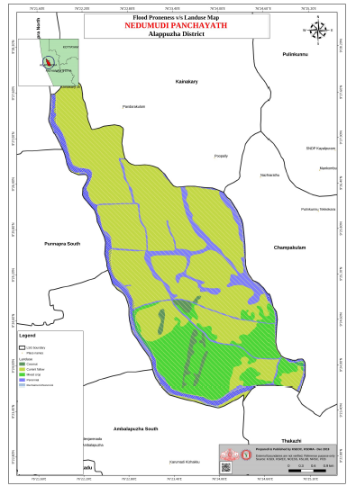
Flood Proneness and Land Use

Slide 55
CHAPTER -3
Disaster Response Plan
Details about the teams to be formed for the coordination during the time of disaster.

Slide 56
Key factors to be considered while preparation, mitigation and social empowerment activities
CHAPTER -4
Preparation, Mitigation and social empowerment

Slide 57
CHAPTER -5
Capabilities and Resources
Resources and tools to be made available during emergency situations.
Skilled and unskilled human resources
Tools needed during emergency response time.

Slide 58
CHAPTER -6
Climate change adaptation, Disaster reduction and Project suggestions
Projects to support disaster Management
Mitigation
Adaptation
Suggestions to others and tiers

Slide 59
CHAPTER -7
Key Contacts including Phone Numbers
Names, addresses, mobile number details of the authorities / agencies / individuals who can give support, guidance at the time of disaster

Slide 60
Nedumudi GP DM Plan.pdf
Disaster Management plan prepared by Nedumudi GP in Alappuzha District

